Slide 1
A Virtual Cluster Manager using a Hierarchical Model for Cloud Infrastructure
Pongsakorn U-chupala
Kasetsart University
Notes:
Thank you, MC. My name is Pongsakorn U-chupala. From Kasetsart University, Thailand. I’d like to talk about our project, A Virtual Cluster Manager using Hierarchical Model for Cloud Infrastructure

Slide 2
Outline
Introduction
Virtual Machine
Virtual Infrastructure (Cloud Infrastructure)
Virtual Cluster
Problems
Proposal
VC Manager
Hierarchical Model
Evaluation
Conclusion
Notes:
This talk is divided into 3 sections
First, the introduction, I’ll explain some basic knowledge and the problem we’re trying to solve.
Second, Virtual Cluster Manager, our proposed solution to the problem
Lastly, Case Study on our proposed solution compare to existing method

Slide 3
1. Introduction
Notes:
Let’s start from the introduction

Slide 4


Virtual Machine
User
User
User
VM
VM
VM
Physical Machine
Isolated Environment
Notes:
I’ll start by explaining a concept of virtual machine. Let’s say we have a computer here.
Virtual Machine is a technology to create a virtual computer inside a physical, real computer.
We could also create multiple virtual machine inside single physical machine. Each virtual machine could have separated enviroment for each user.
Regular user will find no different between real machine and virtual machine.

Slide 5


Virtual Infrastructure
Administrator
Virtual Infrastructure
Manually configure/manage
each physical machine
Notes:
With VM technology, Let’s say this time, we have a lot of physical machine, each machine also contain a lot of virtual machine. For administrator to manage all of this manually is a very tedious task.
Luckily, we have a technology call Virtual Infrastructure which generalize virtual machine management on a set of physical machine. From administrator perspective, he’ll only need to manage a single large infrastructure instead of separated physical machine.

Slide 6
Virtual Cluster
Virtual Infrastructure
Virtual Cluster
VM
Notes:
With those technologies, It become easy to provide a single virtual machine to user. However, sometime, user need more than 1 VM.
Let’s say we need to provide a number of VM. Each machine have some kind of relationship among one another. We call this set of VM, Virtual Cluster.
It’s not a single VM anymore, It’s a cluster of VM.

Slide 7
Problems
Virtual Infrastructure allows creation/management of each virtual machine as a single unit
Deploying a set of virtual machines and link them together to make a virtual cluster need to be done manually
VM in a VC could span into thousands of machines
Manually maintaining each VM manually is a tedious tasks
Notes:
The problem is…
With VI technology, it’s allow .. as a single, individual unit.

Slide 8
2. Virtual Cluster Manager
Notes:
Our propose solution to this problem is a Virtual Cluster Manager

Slide 9
Virtual Cluster Manager
A utility for virtual cluster management
Single point of operation for deployment, stop/suspension, deletion and monitoring VC
Work in coordination with existing virtual infrastructure management scheme
Flexible enough to manage different kind of VC
Understand complex relationship of VM within a VC
Allow micro-management of components in VC if needed

Slide 10
Layer of Abstraction
Existing VI
management scheme
Virtual Infrastructure
VI Manager
VC Manager
Notes:
So, we have this VI deployed on a number of physical machines. Most VI provides some kind of default management scheme or VI manager.

Slide 11
VC Hierarchical Model
A model to represent virtual cluster
Each VM in a cluster need to be grouped/ranked into a certain hierarchy
Divided into 2 hierarchies
Structural hierarchy
Group similar VMs together
Dependency Hierarchy
Used to determine order of VM in which operation will be performed to
Notes:
Group VM with similar characteristic/role together

Slide 12
1. Structural Hierarchy
Virtual Cluster
VM Type
Virtual Machine
VM Type
Virtual Machine
Virtual Machine
VM Type
Virtual Machine
Virtual Machine
Notes:
VC is divided into 3 tiers

Slide 13
2. Dependency Hierarchy
VM Type 0
VM Type 2
VM Type 1
VM Type 3
VM Type 4

Slide 14
Example VC
Frontend 0
Compute 0
Compute 1
Compute 2
Notes:
Operation of compute machine relies on frontend machine

Slide 15
Example VC
Frontend 0
Compute 0
Compute 1
Compute 2

Slide 16
Example VC
My Virtual Cluster
VM Type: Frontend
VM Type: Compute
Frontend 0
Compute 0
Compute 1
Compute 2

Slide 17
3. Evaluation

Slide 18
Case Study
We have implemented a VC manager with described design using OpenNebula (VI) as a building block
Then did a case study with
OpenNebula-provided utilities (default management scheme)
Our implemented VC manager
Point of interest: Ease of Use

Slide 19
Ease of Use
Deploy an example virtual cluster
Measure “ease of use” with number of commands and template files used to deploy a virtual cluster

Slide 20
Example VC
Frontend 0
Compute 0
Compute 1
Compute 2

Slide 21
Results
Default scheme
2 templates file used
3+n commands invoked
n is a number of compute
VC Manager
3 templates file used
2 commands invoked
Notes:
I’m sorry but I need to skip the detail on how we got these numbers. If you interest, it was explained in detail in the paper.

Slide 22
Results
Although VC manager requires 1 more template, a number of commands used is a lot less than using default management scheme espescially at higher number of compute

Slide 23
Conclusion
“VC manager” is our approach to simplify virtual cluster management
Hierarchical model offer flexibility we want for the manager
Case study we did show that our approach is better the default management scheme

Slide 24
I’d like to thank…
ShimojoLab
Osaka University
Japan Student Services Organization (JASSO)

Slide 25
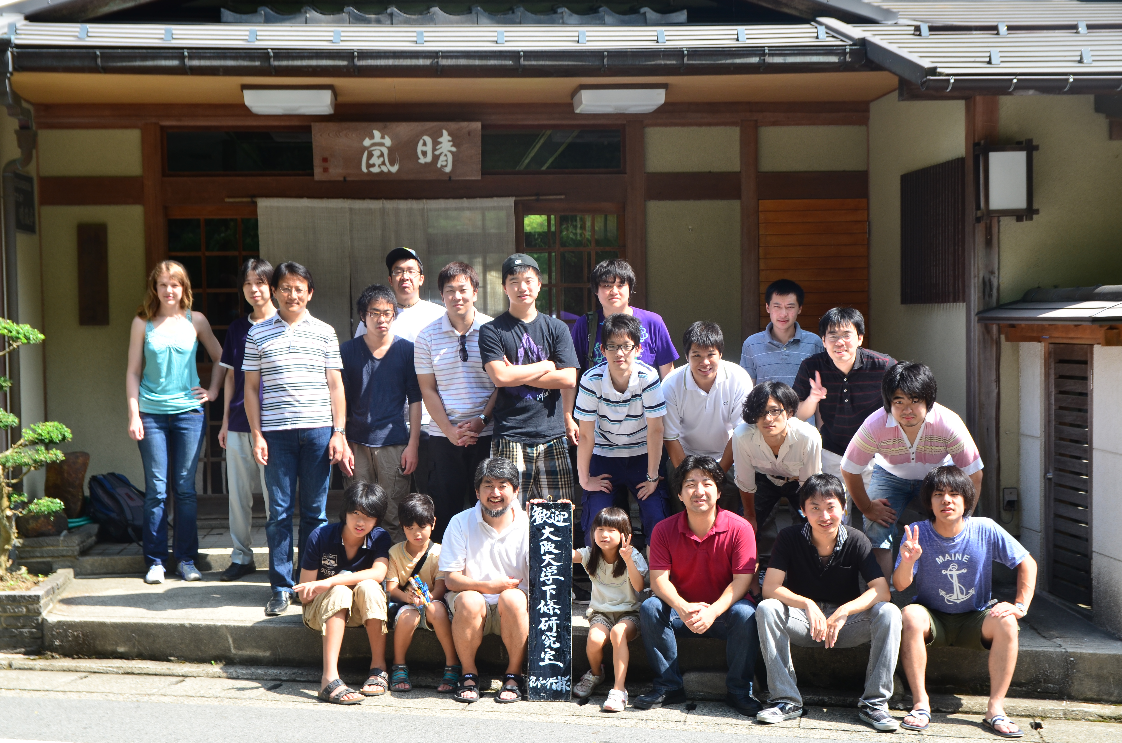
Thank You Very Much!

